Slide 1
2018
Yggdrasil
A library that can take you to the paradise of knowledge.
尹家桐 2016302580138
了然 2016302580055
程奕鑫 2016302580163
张筱 2016302580306

Slide 2
Log in & Sign in
01
contents
The very beginning
Search & Manage
02
From searching to attaching
Read & Comment
03
Absorbed in the pure knowledge
Collection & Log out
04
To the highlight of joy & end
Database details
05
The strong support

Slide 3
1
Log in & Sign in
PART
The very beginning

Slide 4
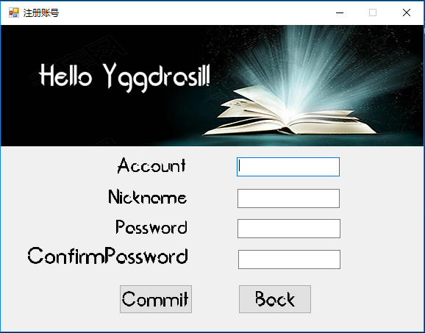
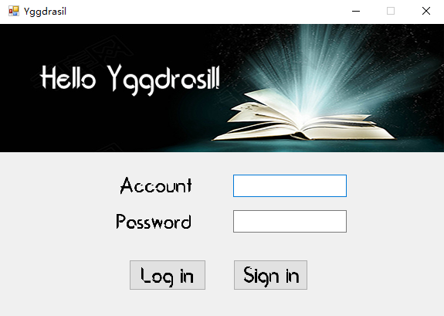

Slide 5
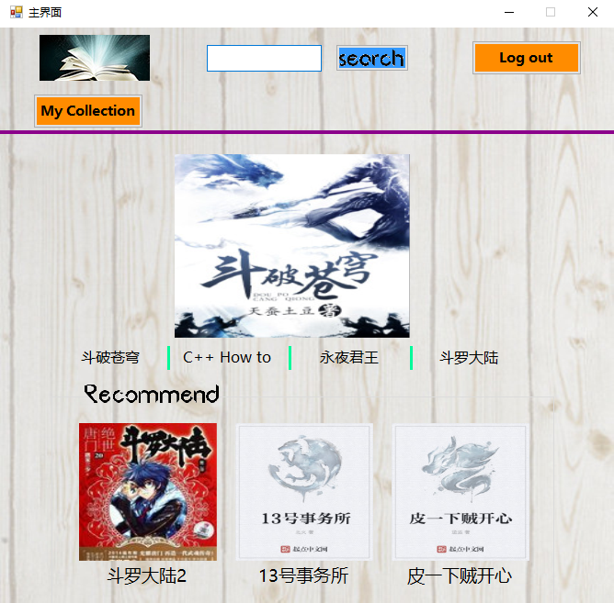
For searching
Log out
Dynamic recommended books
Show collection
Static recommended books

Slide 6
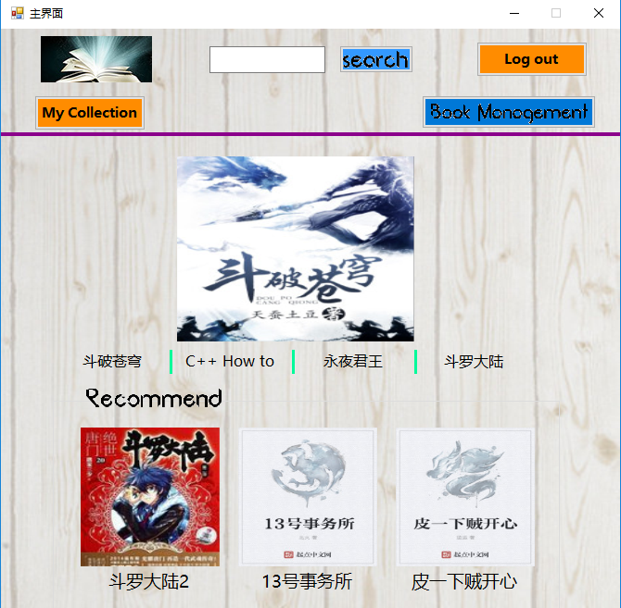
Management for administrators

Slide 7
2
Search & Manage
PART
From searching to attaching

Slide 8
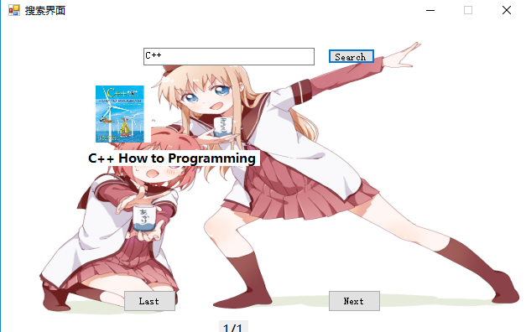

Slide 9
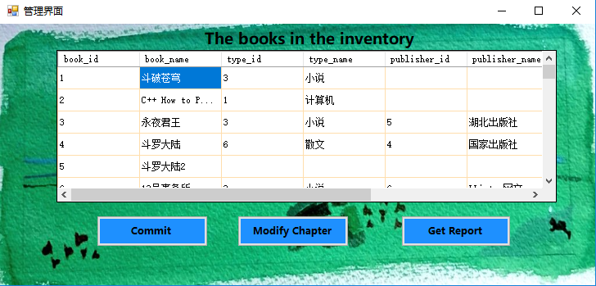
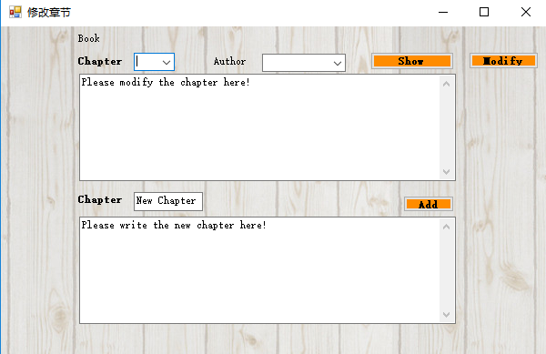
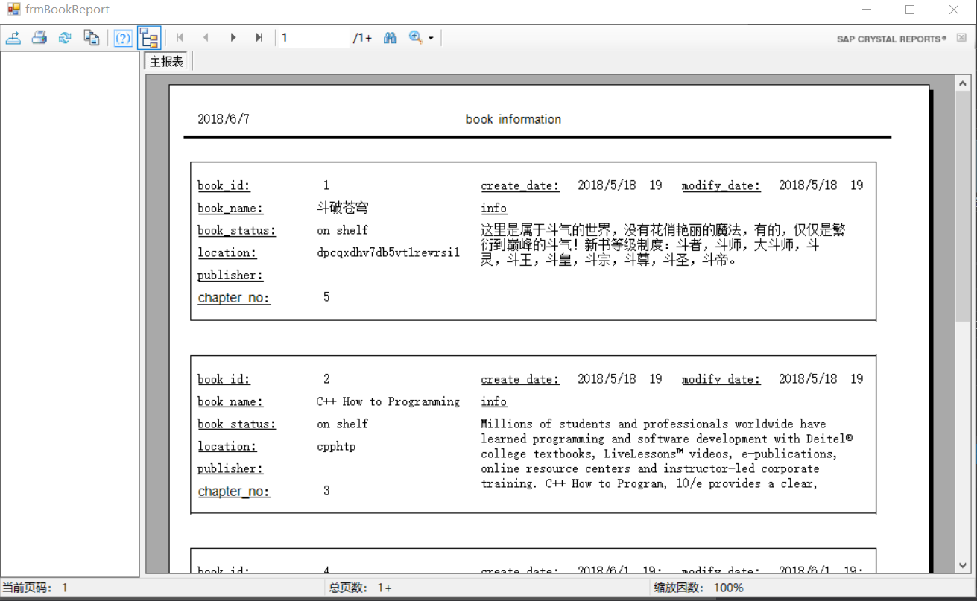

Slide 10
3
Read & Comment
PART
Absorbed in the pure knowledge

Slide 11
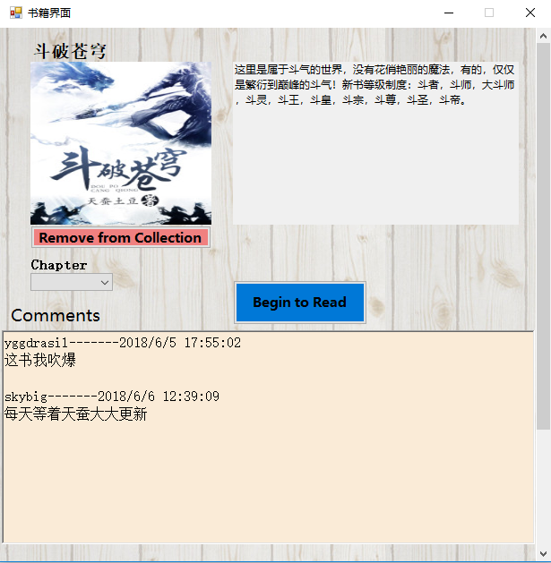
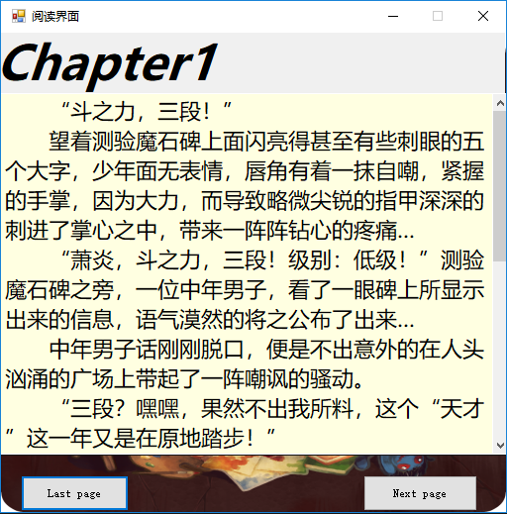
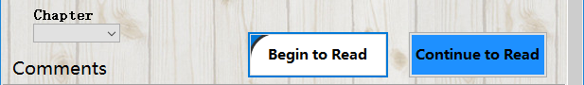
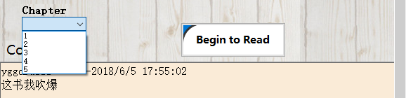


Slide 12
4
Collection & Log out
PART
To the highlight of joy & end

Slide 13
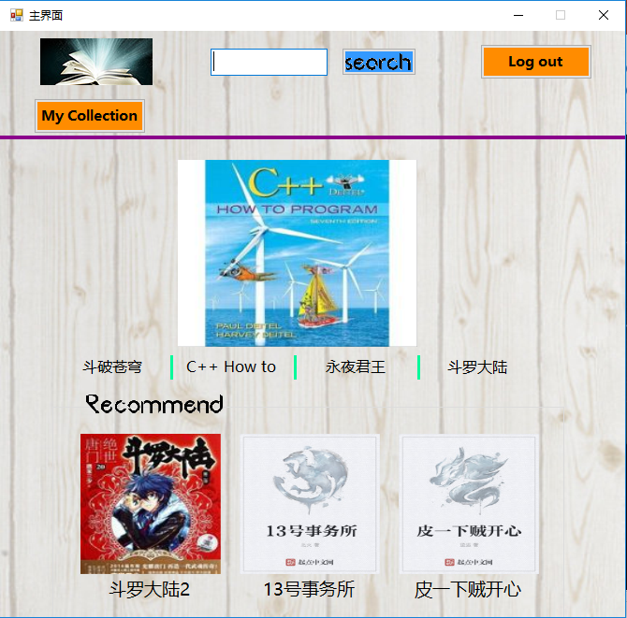
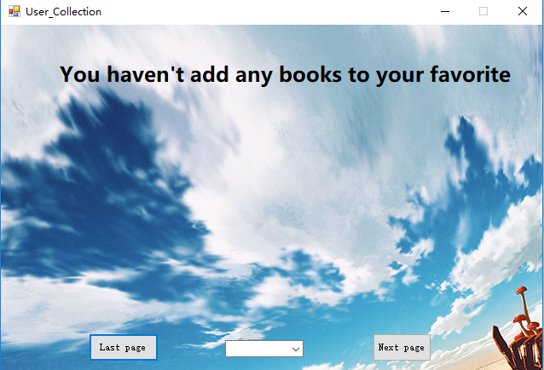

Slide 14
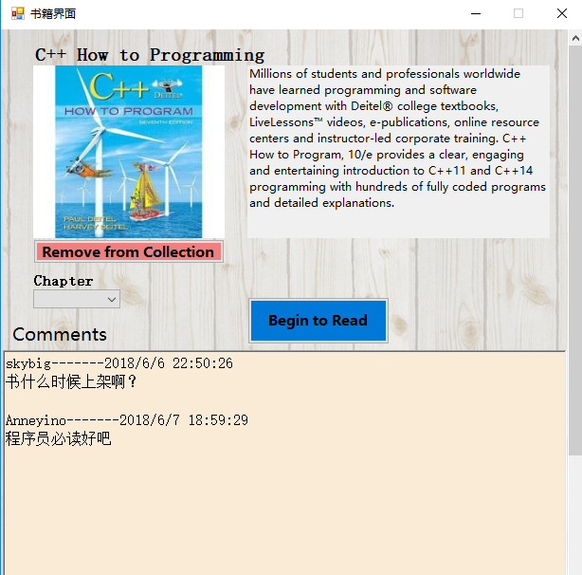
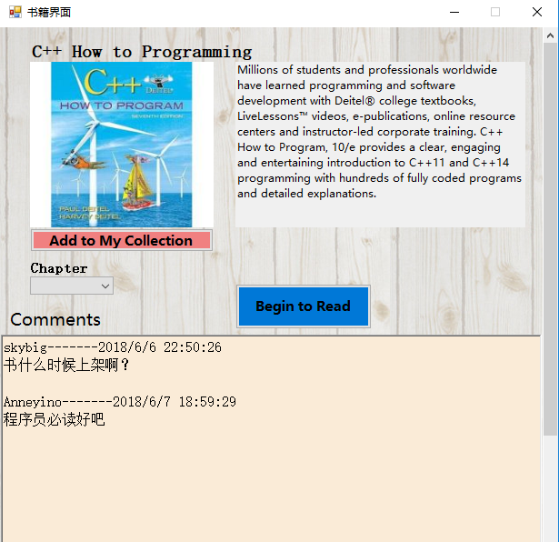
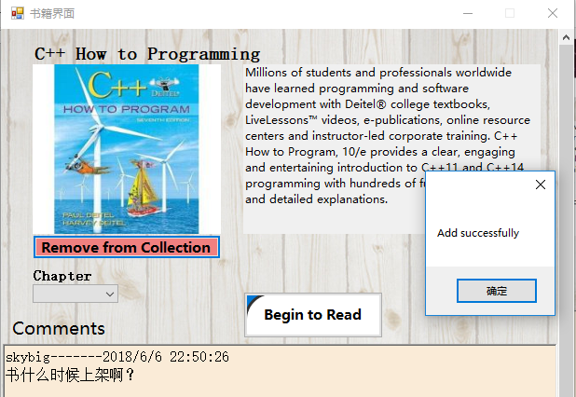
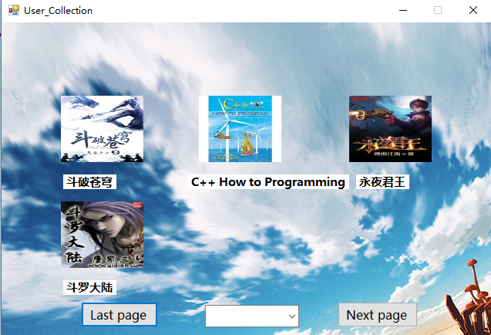

Slide 15
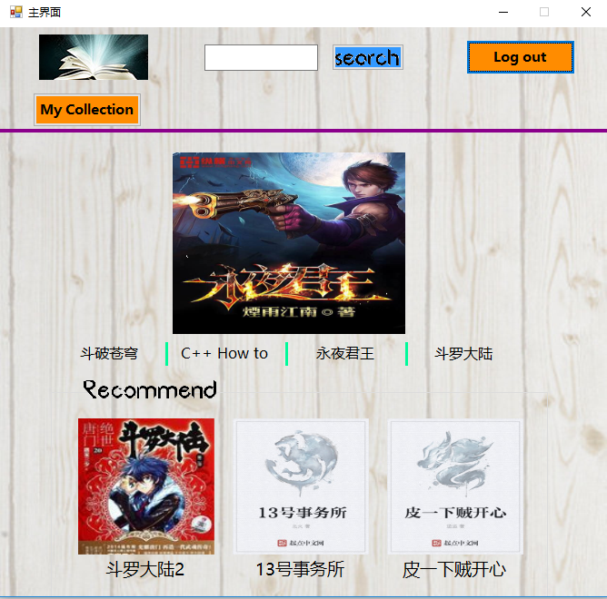
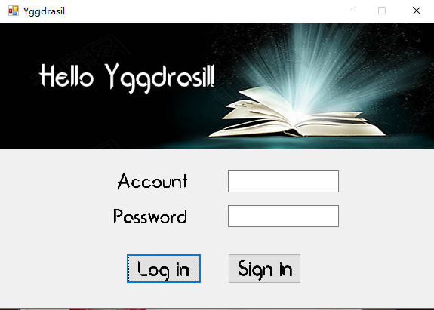

Slide 16
5
Database details
PART
The strong support

Slide 17
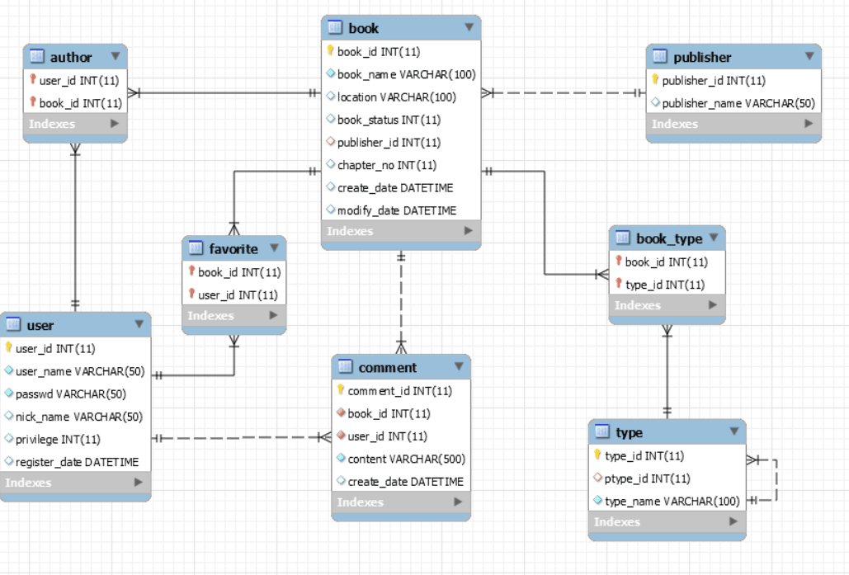
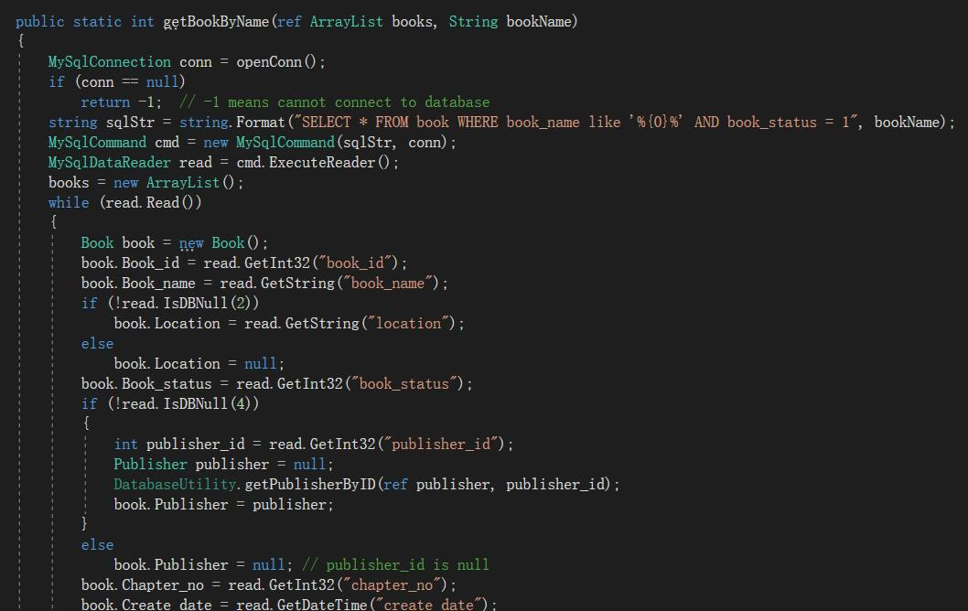
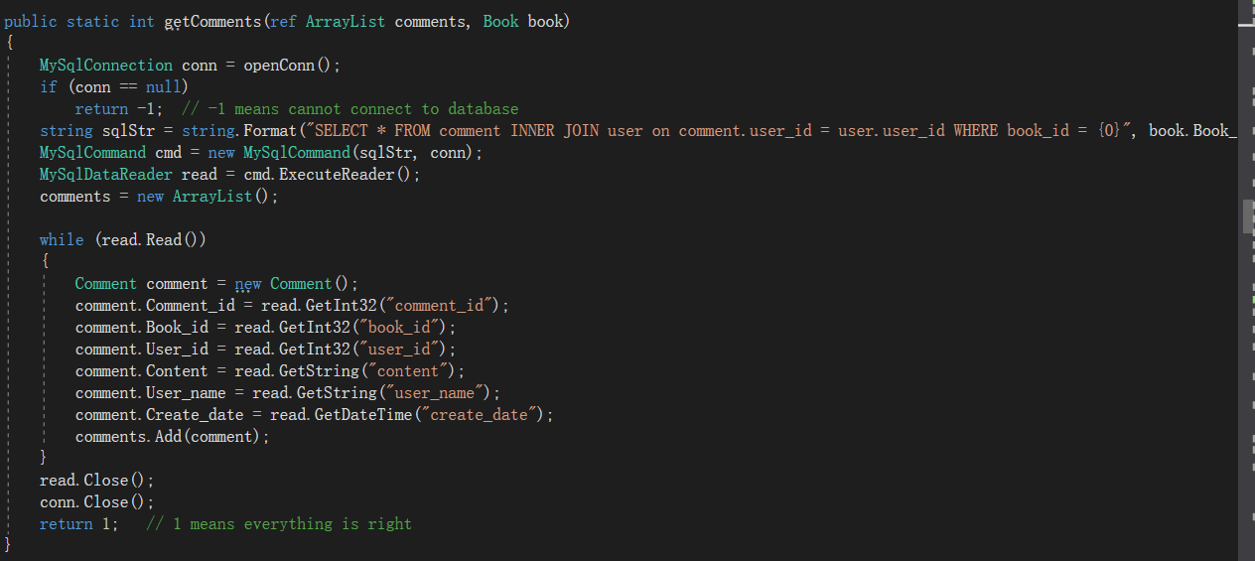

Slide 18
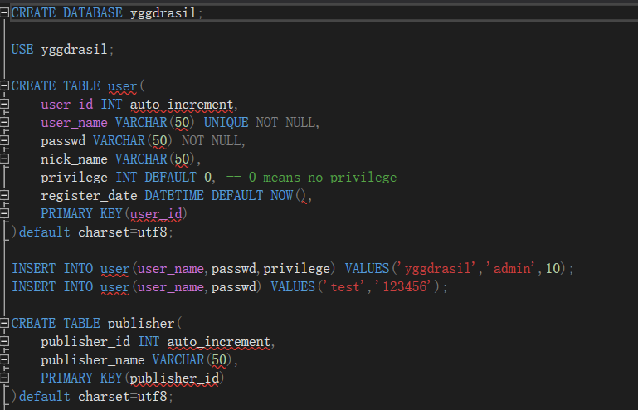
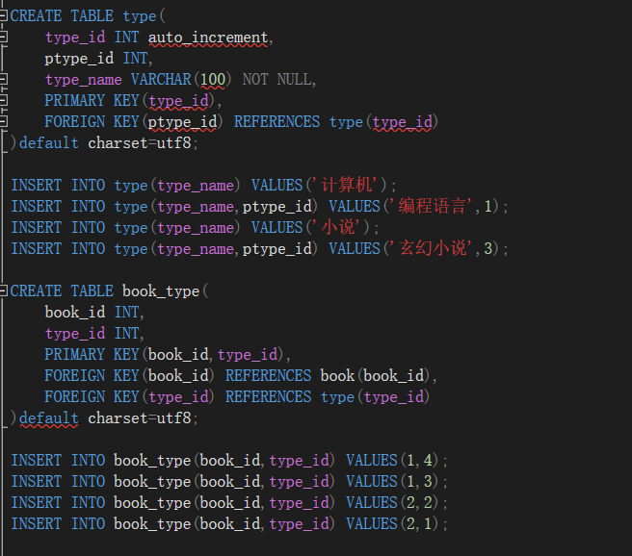

Slide 19
Yggdrasil
Thank you!
Waiting for your discovering.
尹家桐 2016302580138
了然 2016302580055
程奕鑫 2016302580163
张筱 2016302580306

